Slide 1
Recovery Housing Pilot Program

Slide 2
Overview of Topics
Authorization
Intent/Mission
Funding
Potential Applicants
National Objective
Eligible Activities
Deadlines

Slide 3
RHP Pilot Program
Created in response to opioid pandemic
Provide stable, temporary housing to individuals in recovery from substance abuse disorders
Limited 2 years or until permanent housing is secured
Authorized under SUPPORT Act, signed into law October 24, 2018
Based on CDBG, under Title 1 of HCD Act of 1974

Slide 4
Program Intent
HUD’s mission is to serve individuals through 4 dimensions:
Health
Home
Purpose
Community
Program Measures
Housing Stability
Income
Sobriety

Slide 5
Program Funding
$25 million appropriation
25 grantees awarded (24 states and D.C.)
Kentucky’s allocation = $1,116,000 or 4.56% of total
Formula used to allocate funds includes age adjusted rates of drug overdose deaths (70%), unemployment rates (15%), and labor force participation rates (15%)

Slide 6
Potential Applicants
All areas within jurisdiction are eligible, including entitlement and tribal areas
Support Act requires grantees give priority to entities with greatest need, ability to deliver timely assistance
HUD recommends using funds toward projects that complement federally funded projects that serve similar clientele

Slide 7
National Objective
All RHP activities must comply with the Limited Clientele national objective
Must benefit at least 51% low and moderate income persons
Additional limited clientele categories include:
Persons who meet the federal poverty limits
Persons insured by Medicaid
Funds can’t be used to aid in elimination of blighted area

Slide 8
Eligible Activities
Public Facilities and Improvements
Acquisition, construction, reconstruction, rehabilitation or installation of public facilities and improvements for the purpose of providing stable, temporary housing for individuals in recovery from a substance use disorder.

Slide 9
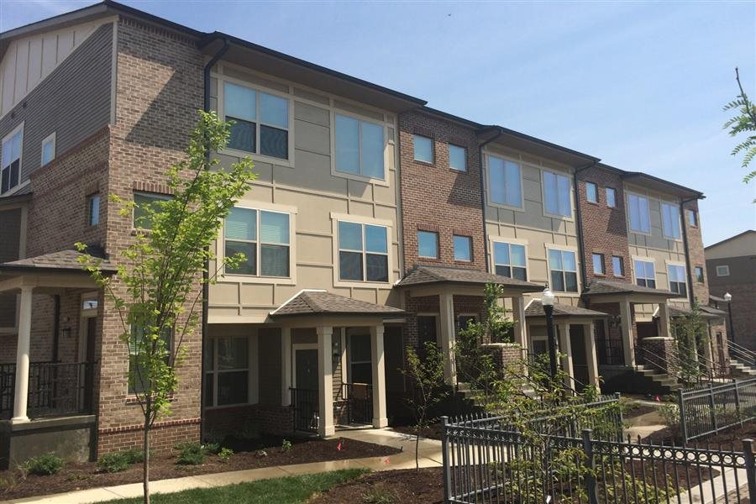
Eligible Activities
Acquisition of Real Property
For the purpose of providing stable, temporary housing to persons in recovery from a substance abuse disorder.

Slide 10
Eligible Activities
Lease, Rent, and Utilities
Payments:
For lease, rent, utilities, and associated costs on behalf of an individual in recovery from a substance use disorder for the purpose of providing stable, temporary housing
Not limited to 15% of the grant
Payments must be made to the provider, such as the landlord or utility provider. Payments must NOT be made directly to individuals.

Slide 11
Eligible Activities
Lease, Rent, and Utilities, continued
Other requirements:
RHP funds may not supplant funds that previously covered these costs
Payments must result in either a new or expanded service
Eligible models:
Traditional tenant-based rental assistance
Master lease model

Slide 12
Eligible Activities
Rehab and reconstruction of:
Single-unit
Multi-unit
Public housing

Slide 13
Eligible Activities
Disposition of Real Property
Disposition through sale, lease, or donation of otherwise of real property acquired with RHP funds for the purpose of providing stable, temporary housing for individuals in recovery from a substance use disorder.

Slide 14
Eligible Activities
Clearance and Demolition
Clearance, demolition, and removal of buildings and improvements, including movement of structures to other sites.
Eligibility limited to projects where RHP funds are used only for the clearance and demolition.

Slide 15
Eligible Activities
Relocation
Relocation payments and other assistance for permanently or temporarily displaced individuals and families in connection with activities using RHP funds.

Slide 16
Eligible Activities
New Construction of Housing
Expansion of existing eligible activities to allow RHP funds to be used for new construction of housing.
New construction of housing is subject to the same requirements that apply to rehabilitation activities.

Slide 17
Important Deadlines
30% of funds must be expended within one year of GA with HUD
100% of funds must be expended by 9/1/27

Slide 18
Comments/Questions?
Contact Info
Mark Williams (markp.williams@ky.gov)
John Brady (john.brady@ky.gov)
Resources
https://www.hudexchange.info/programs/rhp/

